Slide 1
Introduktion til Programmering og Problemløsning (PoP)
Jon Sporring
Department of Computer Science
2021/10/07

Slide 2
Hvor langt er I kommet med materialet?
https://tinyurl.com/mtx48bbp

Slide 3
Hvad er værdien og typen
https://tinyurl.com/4ethtv6t

Slide 4
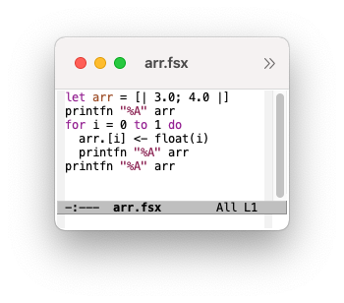
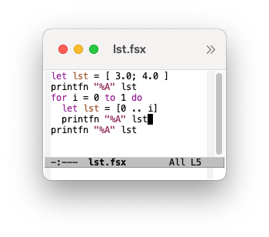
Arrays vs. lists
Hvad skriver programmet?
https://tinyurl.com/549mne7x

Slide 5
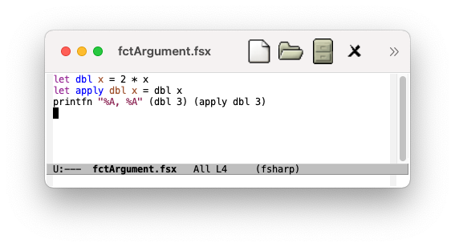
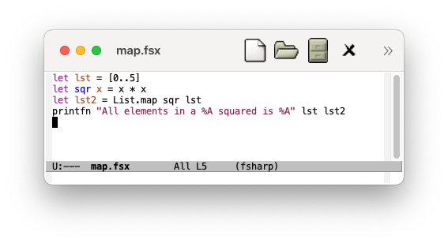
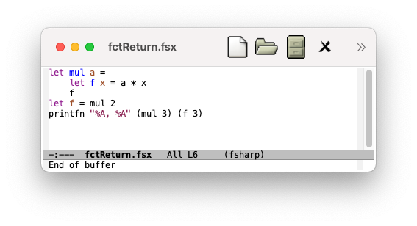
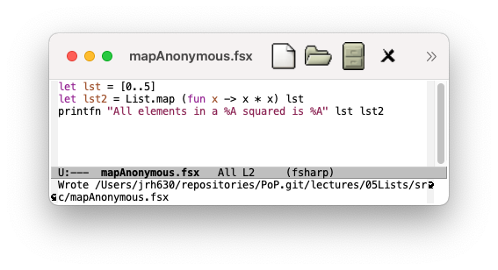
Funktioner som argumenter og returværdi

Slide 6
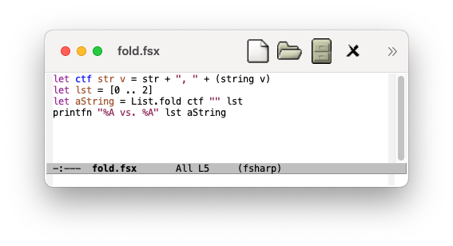
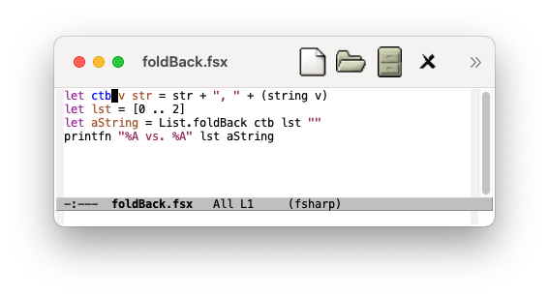
List.fold og List.foldBack
List.fold tager en funktion f a b -> a, a, en liste af b og returnerer a typer.
Hvad er typen?
% fsharpi
Microsoft (R) F# Interactive version 11.0.0.0 for F# 5.0
Copyright (c) Microsoft Corporation. All Rights Reserved.
For help type #help;;
> List.fold;;
val it : (('a -> 'b -> 'a) -> 'a -> 'b list -> 'a)
> List.foldBack;;
val it : (('a -> 'b -> 'b) -> 'a list -> 'b -> 'b)
Vilkårlig type ‘a og ‘b
List.fold: ctf (ctf (ctf "" 0) 1) 2
List.foldBack tager en funktion f a b -> b, en liste af a, b og returnerer b.
List.foldBack: ctb 0 (ctb 1 (ctb 2 ""))

Slide 7
List.fold og List.foldBack
Hvordan kan man bruge fold hhv. foldBak men undgå det foranstillede “, “?

Slide 8
List.fold og List.foldback med anonyme funktioner
Sum en liste af heltal:
v1
let add a b = a+b
List.fold add 0 [1..5]
v2
let add a b = a+b in List.fold add 0 [1..5]
v3
List.fold (fun acc elm -> acc + elm) 0 [1..5]
v4
List.foldBack (fun elm acc -> acc + elm) [1..5] 0
Debugging med printfn og sekvenser af udsagn:
List.fold (fun acc elm -> printfn "%d" acc; acc + elm) 0 [1..5]
List.foldBack (fun elm acc -> printfn "%d" acc; acc + elm) [1..5] 0

Slide 9
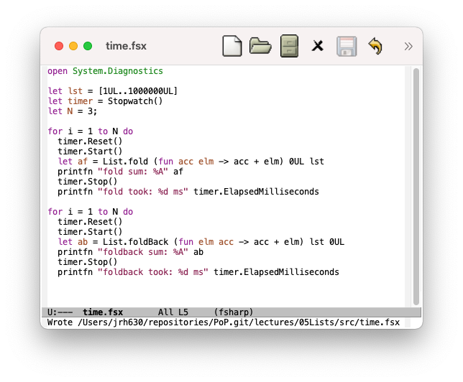
Hvor lang tid tager det?
% fsharpi time.fsx
fold sum: 500000500000UL
fold took: 37 ms
fold sum: 500000500000UL
fold took: 4 ms
fold sum: 500000500000UL
fold took: 2 ms
foldback sum: 500000500000UL
foldback took: 17 ms
foldback sum: 500000500000UL
foldback took: 11 ms
foldback sum: 500000500000UL
foldback took: 13 ms
% fsharpc time.fsx && mono time.exe
Microsoft (R) F# Compiler version 11.0.0.0 for F# 5.0
Copyright (c) Microsoft Corporation. All Rights Reserved.
fold sum: 500000500000UL
fold took: 162 ms
fold sum: 500000500000UL
fold took: 5 ms
fold sum: 500000500000UL
fold took: 2 ms
foldback sum: 500000500000UL
foldback took: 15 ms
foldback sum: 500000500000UL
foldback took: 12 ms
foldback sum: 500000500000UL
foldback took: 9 ms

Slide 10
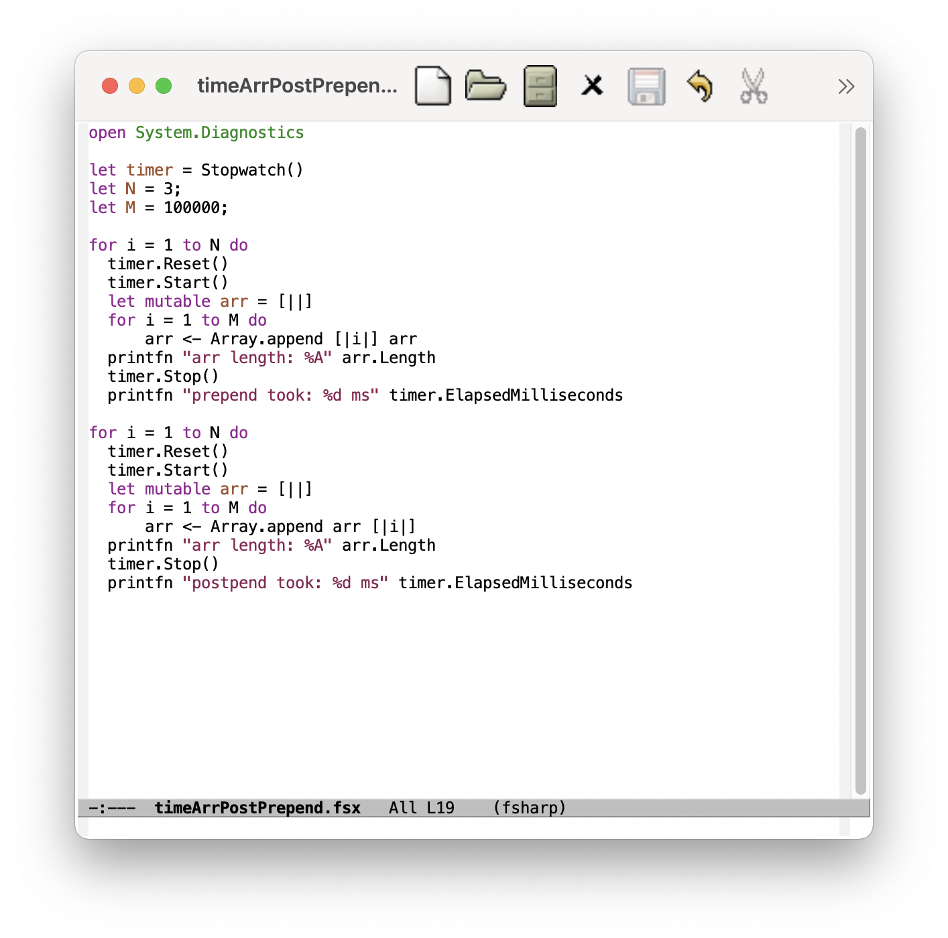
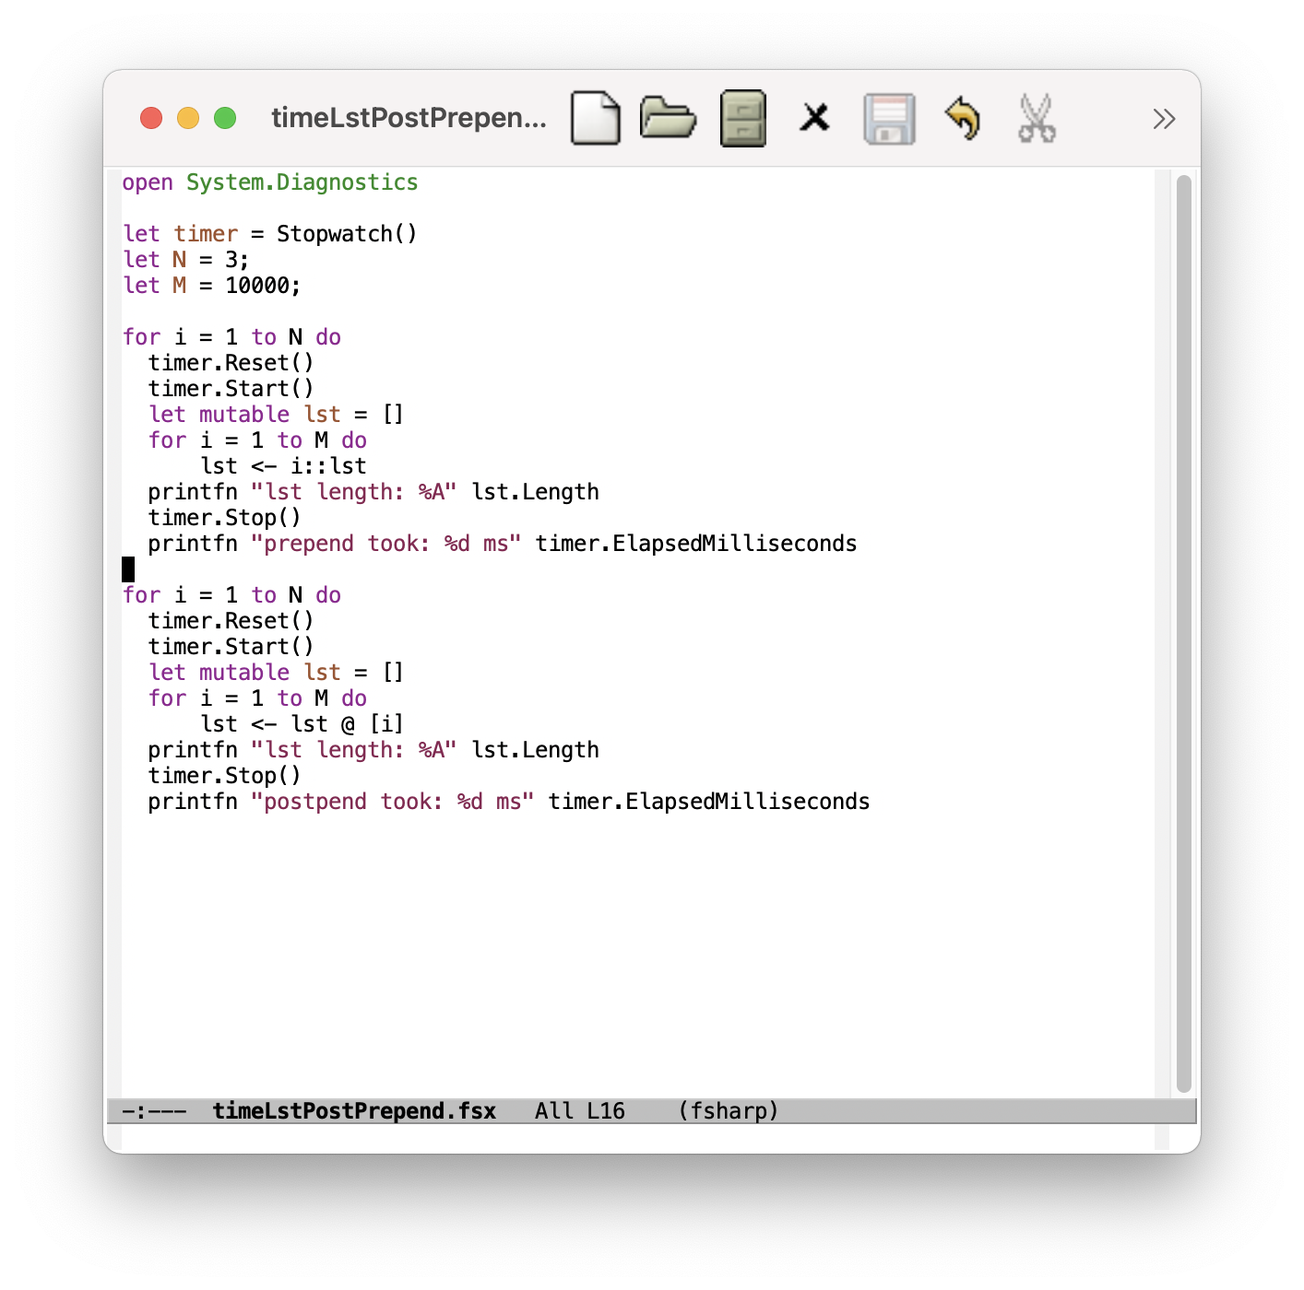
Hvor lang tid tager det?

Slide 11
Spørgsmål

